Slide 1

Artificial Neural Network: Epoch, Iteration and Batch in Machine Learning
Mina Farmanbar
Associate Professor, University of Stavanger
for engineers

Slide 2
Epoch
Epoch refers to one complete pass of the training dataset through the model.
But, in this scenario, you will face an issue while feeding a bunch of training data in the model.
This issue happens due to limitations of computer storage.

Slide 3
Batch
This process is called batch in machine learning, and further, when all batches are fed exactly once to train the model, then this entire procedure is known as Epoch.
To overcome this issue, we have to break the training data into small batches according to the computer memory or storage capacity.

Slide 4
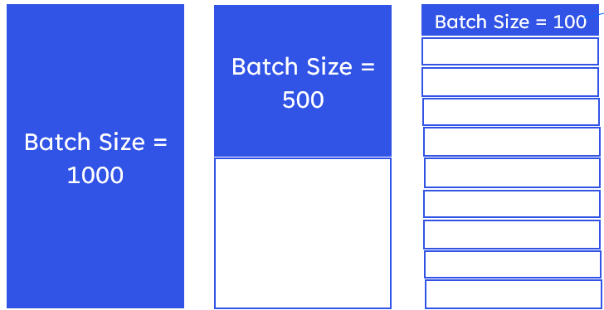
Iteration
Iteration is defined as a total number of batches required to complete one epoch, where a number of batches are equal to the total number of iterations for one epoch. Here we have 1000 samples.
Total Number of
Training samples
Iteration per
Epoch = 1
Iteration per
Epoch = 2
Iteration per
Epoch = 10

Slide 5
Thank you!
Mina Farmanbar
mina.farmanbar@uis.no

